Slide 1
Managing Documents the Right Way
IA354
Amanda Murphy

Slide 2
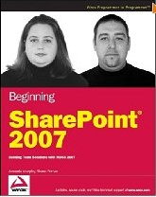
Amanda Murphy, MVP, BBA, MCTS
Located in Newfoundland, Canada
Infotech - www.infotechsolutions.com
Co-Author of Beginning SharePoint 2007: Building Team Solutions with MOSS 2007
Blog: http://blog.funknstyle.com
Email: amanda.murphy@infotechsolutions.com

Slide 3
Presentation Outline
What you need to know before you start.
Setting Objectives
Creating a classification plan.
Creating a document structure.
Ensuring User adoption

Slide 4
The Importance of a Plan
“The best thing about SharePoint is that it is so easy to implement and just start using.”
Some Guy
“The worst thing about SharePoint is that it is so easy to implement and just start using.”
Same Guy (Later)

Slide 5
Why Do Orgs Implement SharePoint?
Improve timely access to information
Standardize how information is organized, shared, and managed.
Increase organizational efficiency by improving business processes.

Slide 6
Set Your Objectives
Identify and document your objectives:
“Create a single repository for the storage of all organizational documents”.
“Create a collaborative location for all new projects”.
“Implement standardization related to the creation of all new documents”.
“Reduce the time it takes to locate important information”

Slide 7
Control vs Comfort
Find the balance that works for your organization.
Provide control while still allowing for users to work in a way that is comfortable and natural.
Comfort
Control

Slide 8
Planning Best Practices
Involve direct interaction with business stakeholders.
Don’t over-commit, over-control or over-classify.
Include an information analyst or architect with experience in planning for enterprise content management systems.
If using external help, ensure that knowledge transfer is taking place for internal staff.

Slide 9
A High Level Plan
Identify what documents will be stored.
Define the types of documents.
Determine the access requirements.
Determine the hierarchy. (On Paper)
Implement the design
Collect continuous feedback.
Use phases and manage change.

Slide 10
Determine What Will be Stored in SharePoint
What are the “types” of information?
How should this content be presented to users?
How will users expect to locate this content?
Who will be accessing the system?
How will they be allowed to interact with the content?

Slide 11
Determine What Not to Store in SharePoint
Large Files
Server Side Scripts
Databases
Files with long file names
Files with special characters in name
(i.e.: " # % & * : < > ? \ { | } ~ . )
Duplicate content already stored in other systems.
http://blogs.msdn.com/joelo/archive/2007/11/08/what-not-to-store-in-sharepoint.aspx

Slide 12
Defining the Documents
Once you have identified “What” will be stored in SharePoint, you then must define the various types of documents by outlining:
Metadata
Policies (Auditing, Expiration, Labels, etc…)
Workflows
Templates
Document Information Panel
Document Conversion

Slide 13
Best Practices for Content Types
Use where possible to increase manageability, standardization and usability.
Plan structure thoroughly before implementation. Difficult to change later.
Create at top level site where reasonable.
For multiple site collections, develop programmatically and deploy as features.
Don’t over define your content types.

Slide 14
#1 - Collect List of Content Types
Examples:
Sales Proposal
Sales Quote
Project Charter
Project Schedule
Technical Documentation
Specification Document
Training Manual
Training Presentation

Slide 15
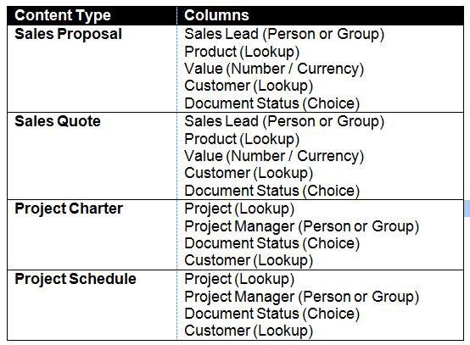
#2 – Collect List of Site Columns

Slide 16
Plan Content Type Hierarchy
Company Document
Sales Document
Project Document
Sales
Proposal
Sales Quote
Project
Charter
Project Schedule
Documentation
Technical Documentation
Specification Document
Training Document
Training Manual
Training Presentation
Document

Slide 17
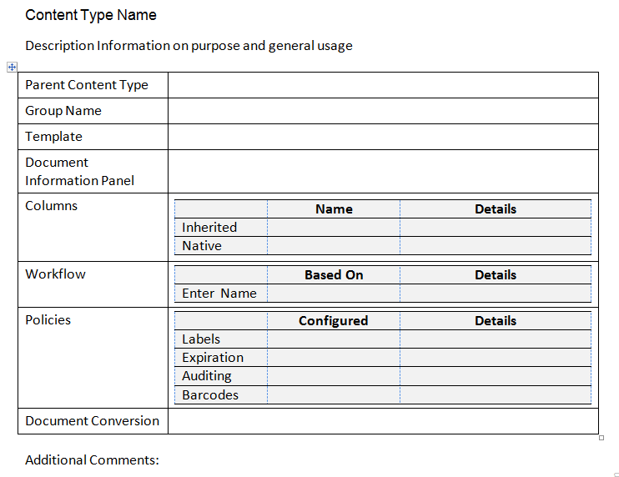
Thoroughly Define Content Types

Slide 18
Content Types
Implementing Your

Slide 19
Common Myths – The File Share
“When SharePoint is implemented, all file shares will be gone.”
“Our file shares are a mess. Once we move everything to SharePoint, our problems will be solved forever.”
“We can move everything from our file share to SharePoint by just copying and pasting.”

Slide 20
Planning Your Hierarchy
Consider multiple ways in which users will seek information.
Minimize clicks but don’t clutter.
Consider various types of users and how they may wish to view content.
Design with future growth in mind.
Avoid approaching known limits (ex. 2000 direct children)

Slide 21
Common Myths – The Folder
“A quick way to minimize efforts associated with migration is to copy and paste folder structures directly from file share”.
And then the other extreme…
“Don’t use folders ever!” If you use metadata, you don’t need to use folders.

Slide 22
Best Practices - Folders
Use where logical based on security and scale requirements.
Consider use of folders for managing permissions versus new libraries or document level security.
Do not use folders as a means of classification. Use metadata for classification.
Avoid views containing too many files.
Consider grouping based on content types if applicable.
Avoid structures that exceed 1 or 2 levels.

Slide 23
Folders
The Right Way to Use

Slide 24
Ensuring User Adoption…
There is no one size fits all to your implementation. Personalize!
Your business users can give you many of the answers your planning team will struggle with.
Don’t skip planning no matter how tight your timeline.
Find the balance between control and comfort.

Slide 25
Thank you for attending!
Please be sure to fill out your session evaluation!

Slide 26
Thank you for attending!
Post conference DVD with all slide decks
Sponsored by

